Slide 1


EmPhAsIS Empowering Pharmacists in Asthma management through Interactive SMS
Follow-up Procedures:
Intervention Pharmacy, Monthly Follow-up and WelTel Platform
emphasis.core.ubc.ca
Click for more information

Slide 2
EmPhAsIS Empowering Pharmacists in Asthma management through Interactive SMS
To review how to recruit and screen a potential study participant,
please see the previous mini-webinar on:
“Baseline Procedures: Recruiting and Screening Patients”
To review how to consent and enroll a potential study participant,
please see the previous mini-webinar on:
“Baseline Procedures: Consenting and Enrolling Patients”
To review how to register patients into the WelTel platform and initiate text messages, please see previous mini-webinar on:
“Baseline Procedures: Intervention Pharmacy, Next Steps”

Slide 3

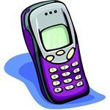
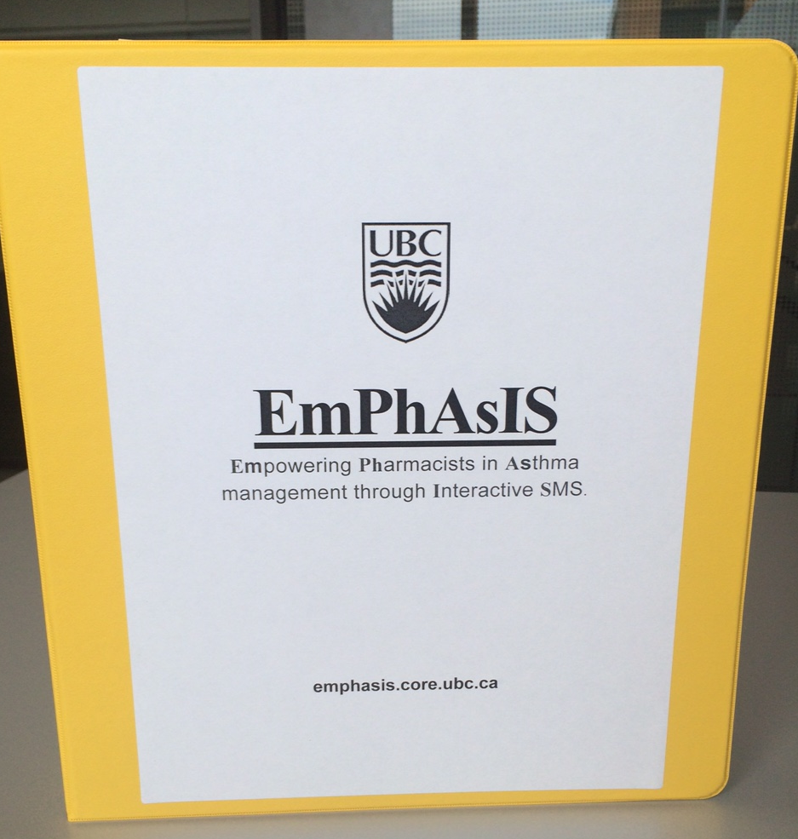
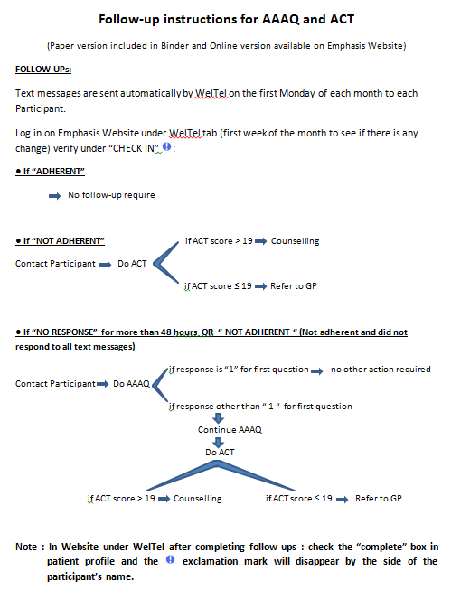
Monthly Follow-up Procedures
+
Check monthly SMS (“checkins”)
Patient responses to monthly SMS in WelTel platform)
Follow-up non-adherent patients by telephone (if needed)
In your binder
Follow-up Instructions for AAAQ and ACT (laminated)

Slide 4
1. Checkins
+
Standardized sending of text messages on the first Monday of every month via WelTel
You will not have to do anything with respect to texting participant yourself
Tip:
Incorporate monthly SMS checks into workflow by doing “checkins” on WelTel on first Tuesday (or first Wednesday) of the month

Slide 5
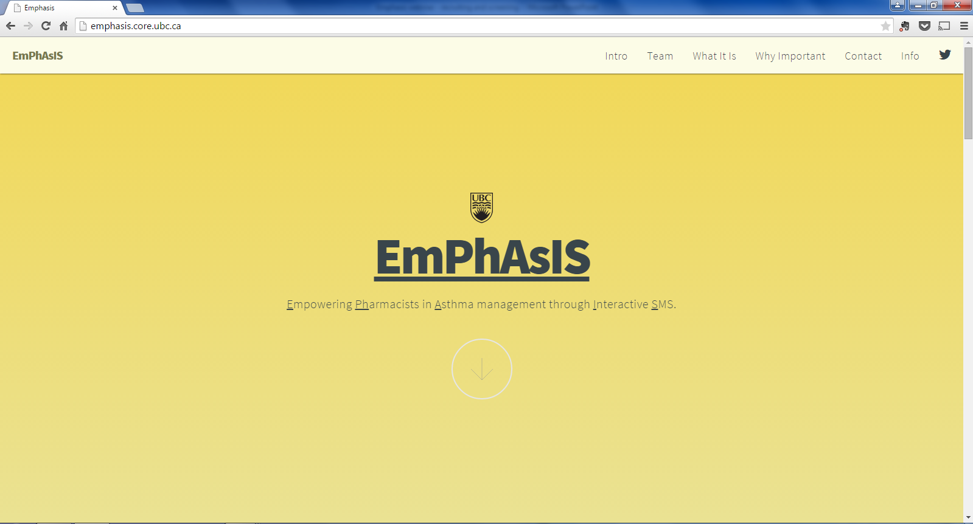
1. Checkins
+
Go to the EmPhAsIS study website: emphasis.core.ubc.ca
Click on Info

Slide 6
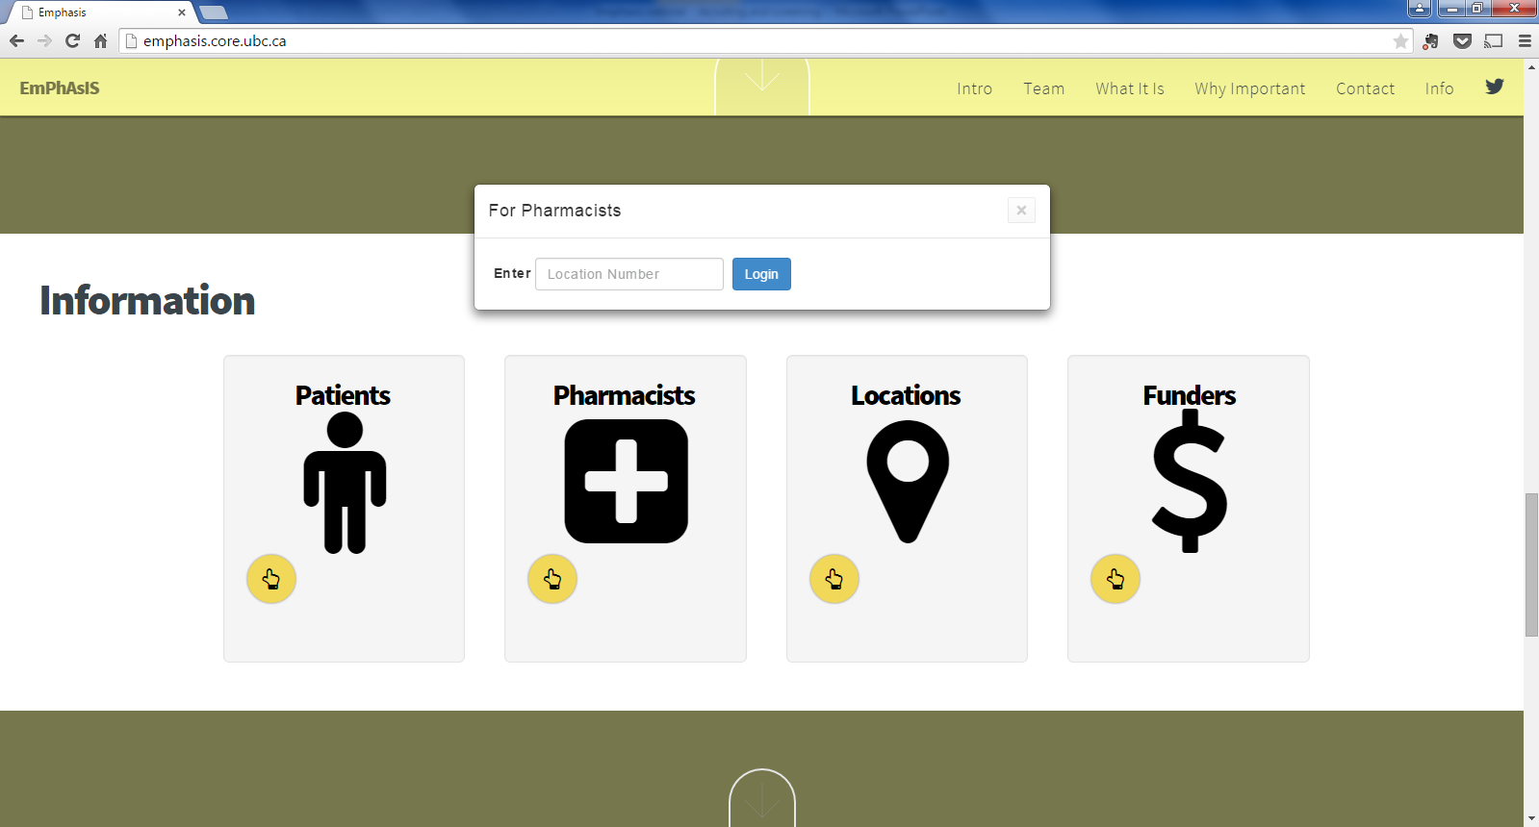
1. Checkins
+
Enter your Username
(i.e. phar007)
Click on Pharmacists

Slide 7
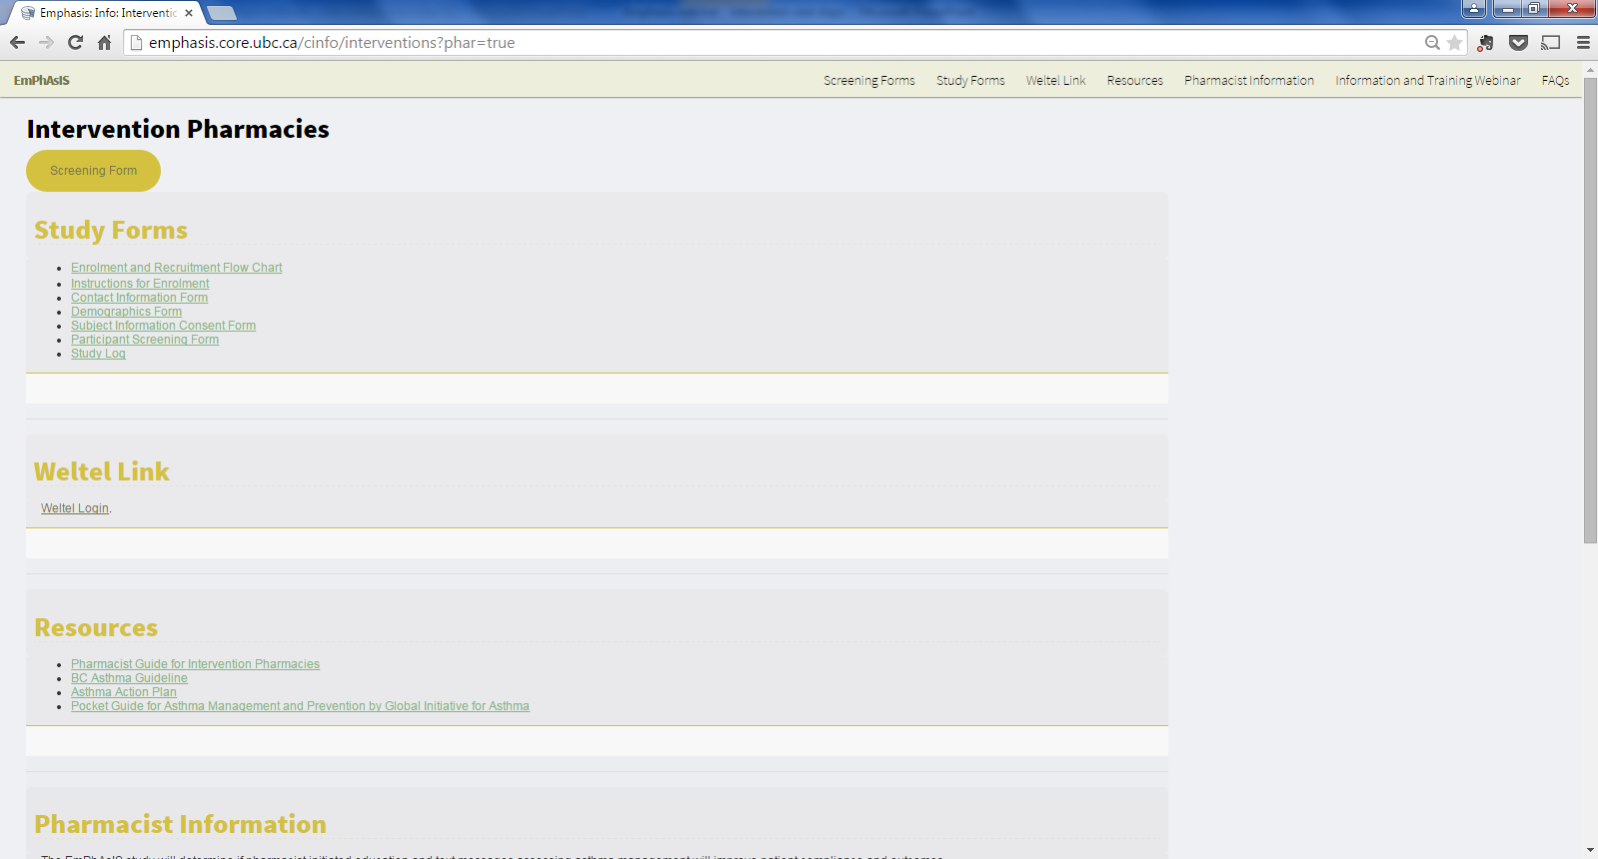
1. Checkins
+
Click on
WelTel Login

Slide 8
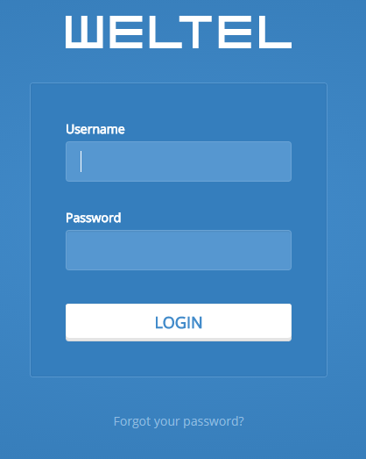
1. Checkins
+
Enter Username
(i.e. phar007)
Enter password (created by you)

Slide 9
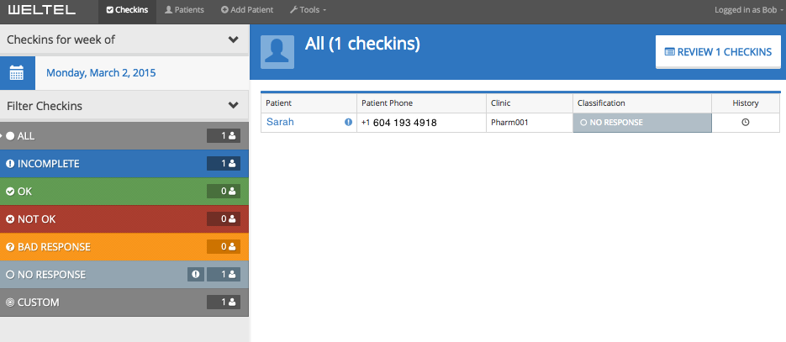



1. Checkins
+
‘Checkins’ view for all patients (# according to Status)
Green = # of ADHERENT checkins
Red = # of NOT ADHERENT checkins
Gray = # checkins with NO RESPONSE

Slide 10
1. Checkins
+
‘Checkins’ view for all patients (List)
Symbol indicates ‘checkins’ needing review
Click on symbol to check new message
Click on patient’s name to view profile and SMS history

Slide 11
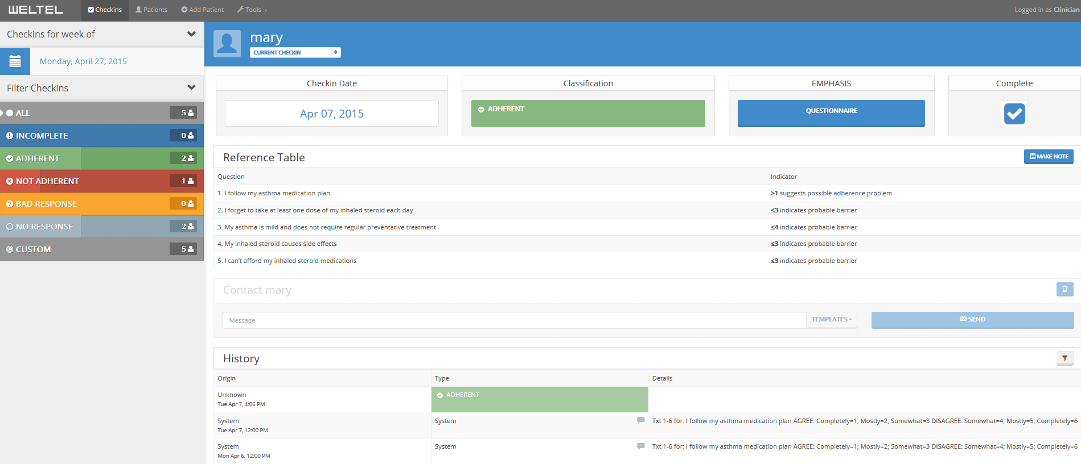
1. Checkins
+
Profile view for individual patient
1. Checkin status
4. Complete box indicates monthly checkin was completed and reviewed by you
(Tip: Important to check this for NOT ADHERENT patients)
3. Access to AAAQ or ACT
2. SMS send and response History
(Tip: “Read up”, oldest text on bottom)

Slide 12
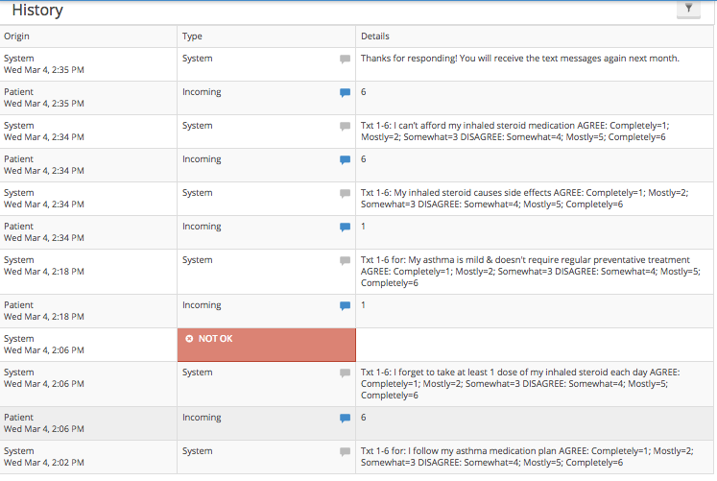
1. Checkins
+
Patient’s response
Message sent by WelTel

Slide 13
1. Checkins
+
Follow-up questions
after identification of
non-adherence. If
adherent, patient will not
receive these texts
Identification of
non-adherence

Slide 14
2. Follow-up Non-Adherent Patients
+
Tools
AAAQ Questions 2 to 5 to identify adherence barrier
Texted to patients OR
Accessible via WelTel OR
AAAQ Form (in binder)
Asthma Control Test (ACT) to assess asthma control
Accessible via WelTel OR
ACT Form (in binder)
Your role in this step is the most important part of the EmPhAsIS study
Because this is a pragmatic study, please provide counselling according to your practice but we have provided you with some tools to help

Slide 15
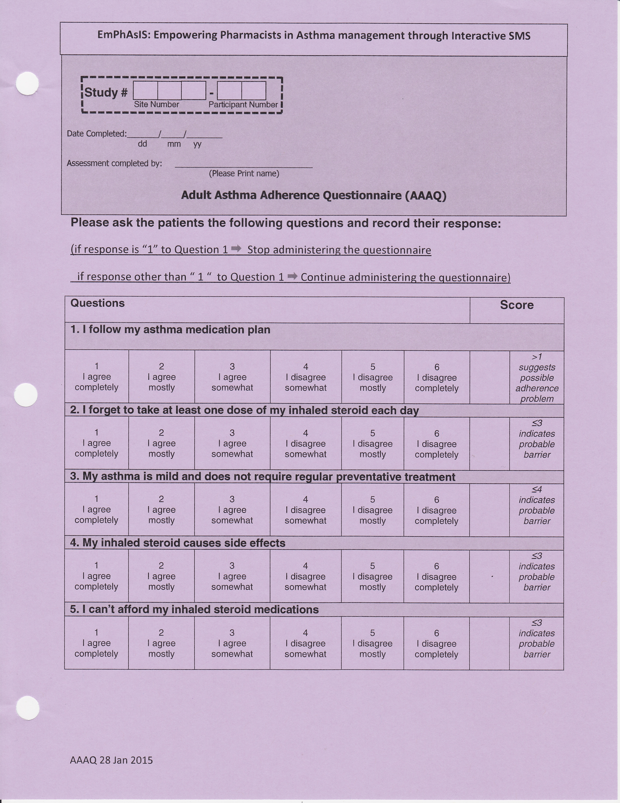
2. Follow-up Non-Adherent Patients
+
Why the AAAQ?
By identifying potential adherence barrier, we hope this tool will facilitate your counselling
Please note: This is provided as a tool and while we encourage its use, you may decide to use/not use

Slide 16
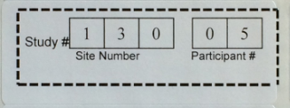
2. Follow-up Non-Adherent Patients
+
Why the AAAQ?
By identifying potential adherence barrier, we hope this tool will facilitate your counselling
Please note: This is provided as a tool and while we encourage its use, you may decide to use/not use
If form was used, please stick the Patient Study ID sticker onto the form

Slide 17
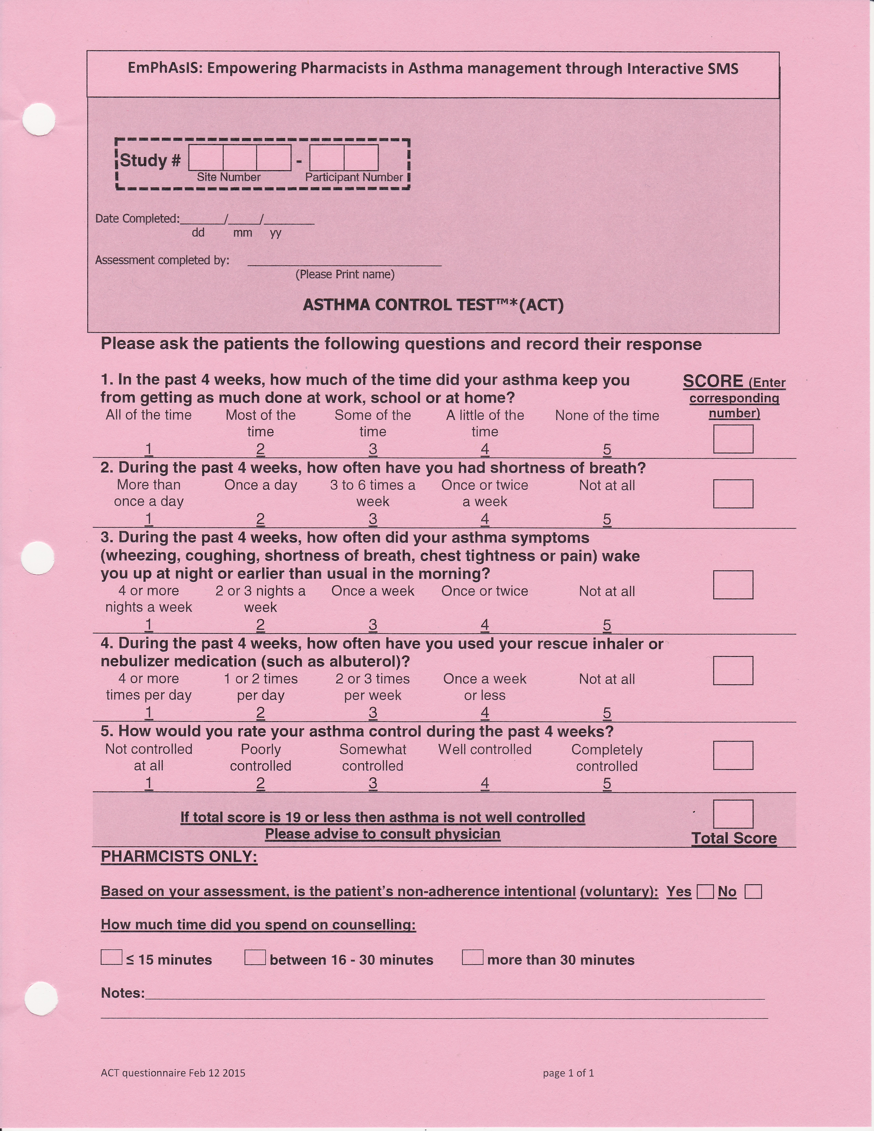
2. Follow-up Non-Adherent Patients
+
Why the ACT?
This allows assessment of asthma control
If total score is 19 or lower, please advise patient to consult their GP
Please note: This is provided as a tool and while we encourage its use, you may decide to use/not use

Slide 18
2. Follow-up Non-Adherent Patients
+
Why the ACT?
This allows assessment of asthma control
If total score is 19 or lower, please advise patient to consult their GP
Please note: This is provided as a tool and while we encourage its use, you may decide to use/not use
If form was used, please stick the Patient Study ID sticker onto the form

Slide 19
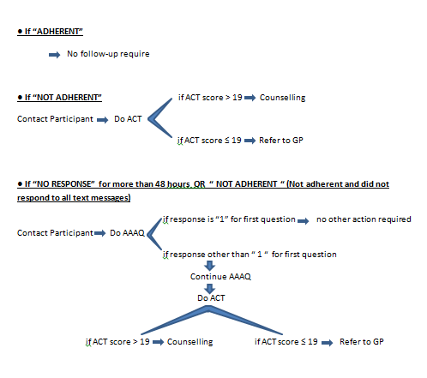
2. Follow-up Non-Adherent Patients
+
From Follow-up Instructions for AAAQ and ACT (laminated card), possible scenarios:

Slide 20
2. Follow-up Non-Adherent Patients
+
If you used the AAAQ Form or the ACT Form to follow-up non-adherent patients
Stick Patient Study ID onto the forms
File completed forms at the back of the study binder
You do not need to fax these forms to UBC

Slide 21
Congratulations!
You have now successfully completed a monthly follow-up with your patients!
If you are unable to follow-up with a non-adherent patient, please notify the study investigators as soon as possible.

Slide 22
EmPhAsIS Empowering Pharmacists in Asthma management through Interactive SMS
Questions?
Please do not hesitate to contact us
Dr. Mary De Vera at 604-827-2138 (mdevera@mail.ubc.ca)
Research Coordinator (Louise) at 604-827-1567 (louisega@mail.ubc.ca)
Fax: 604-827-4014
Mailing Address
2405 Wesbrook Mall, Vancouver BC, Canada V6T 1Z3

